Slide 1
The City of Cincinnati’s Safe and Clean Neighborhood Fund
Ty Wesselkamper
Safe and Clean Grant Coordinator
Ty@KeepCincinnatiBeautiful.org

Slide 2
Mission: We strengthen community-led efforts to improve neighborhood livability with the strategic stewardship of City investments.
Improve safety
Eliminate blight
Increase livability
Priority focus for projects serving youth in high-risk neighborhoods.
Friday May 10th, 2024 deadline to apply with $190,000 to distribute.
50% of funds will go to Top 10 Neighborhoods with the Highest Statistical Gun Violence.
Wave Pool- Curb Bump Out and Street Mural

Slide 3
Mission Continued: May 10th, 2024 deadline
City is interested in aligning its funding with emergent priorities, including the spike in youth gun violence.
We are encouraging applicants from youth-led projects in communities that experience the highest levels of gun violence(data is obtained by Cincinnati Police Department) to apply.
2023’s Top 10 Neighborhoods:
West End
OTR
Westwood
Roselawn
East Price Hill
Avondale
Winton Hills & CBD/Riverfront- 2 way tie
West Price Hill
Bond Hill & CUF - 2 way tie

Slide 4
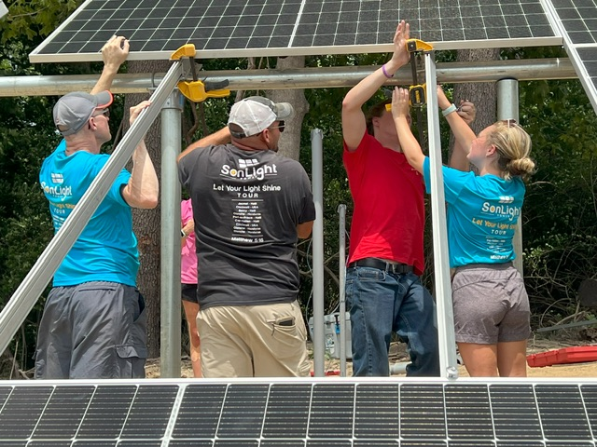
This is a reimbursable grant meaning all expenses, services, materials, & related costs must be paid before submitting for reimbursement.
There are no limits on the number of claim vouchers you submit. Example: you can submit for reimbursement each month, by project area upon completion, or at the end of the project.
What is not eligible for reimbursement:
T-Shirts, other clothing, Food and Beverages, Entertainment , Ongoing expenses, Personnel Costs(Gas, Electric, overhead costs, payroll)
Note- Stipends/Payment to contractors/services are eligible for reimbursement. Example: Gun Safety Expert for Gun Violence Prevention Programming.
SonLight Power at John P. Parker School, Madisonville. SonLight Power received S&C Funds providing a community garden and STEM Learning opportunities for youth, families and community members.

Slide 6
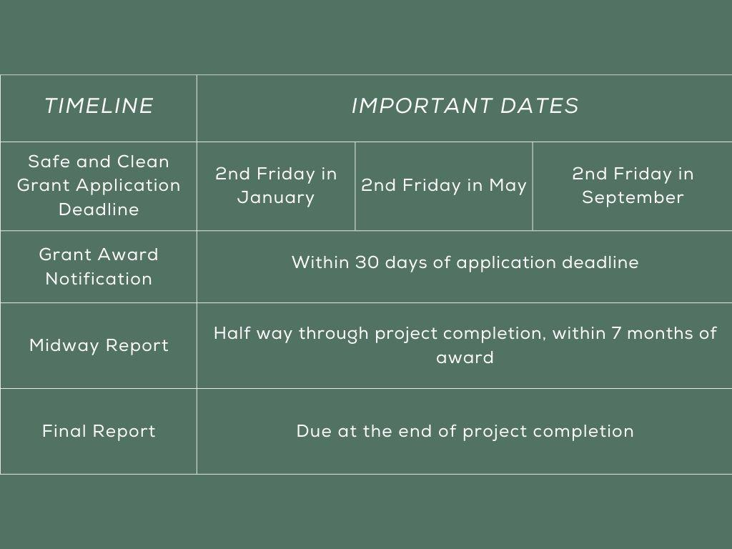

Slide 7
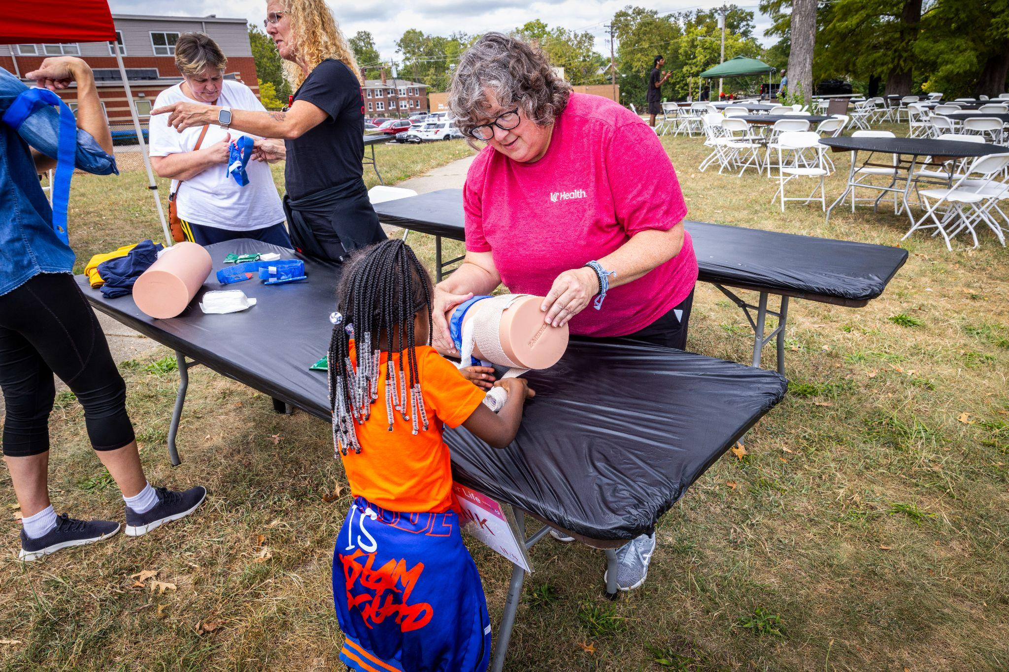
Safe and Clean Grant Term: 1 year term if approved for funding
If the agreement was signed on 6/1/2024 then you’d have until 6/1/2025 make all the purchases necessary for the project that would be eligible for reimbursements.
Midway report is due no later than 7 months after signing agreement.
Final report is due no later than 30 days after your term ends.
Failure to submit both reports will disqualify you from receiving funding until both reports are submitted.
Please note: if you have an open grant with S&C, final report must be turned in to be eligible for the next deadline. Can not have more than one open grant.
Whitney Strong’s Event: Day for Life Event as part of their Save A Life Program, funded by the City of Cincinnati’s Safe and Clean Neighborhood Fund.

Slide 8
Application: S.A.R.A

Slide 9
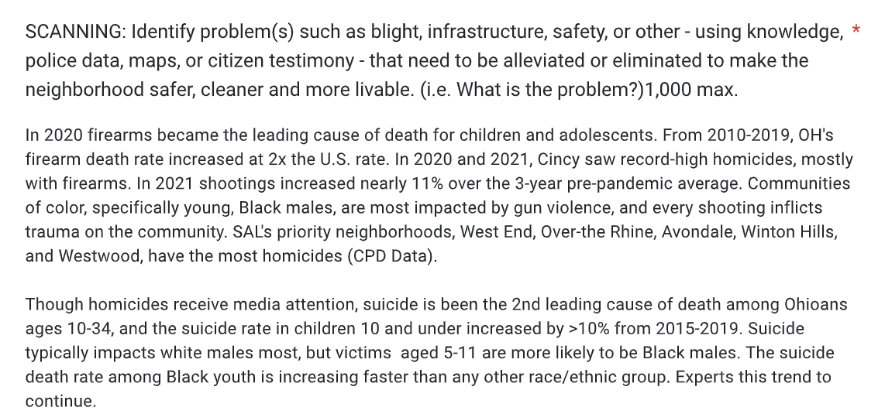
Example of a funded project’s application
clear statement of what is the issue
Used CPD data to determine which communities to reach

Slide 10
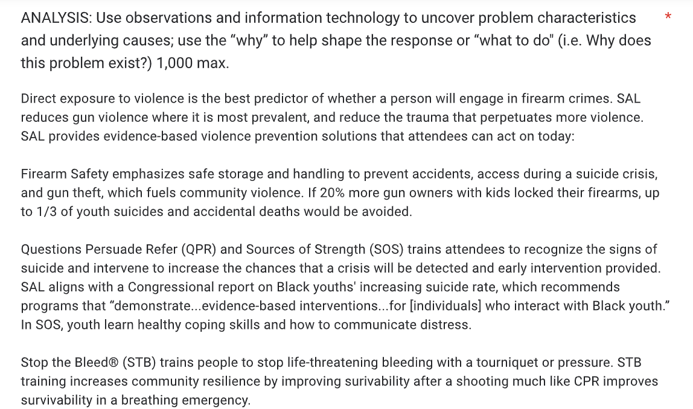
The “Why”
Answers “why does this exist?”
What to do?

Slide 11
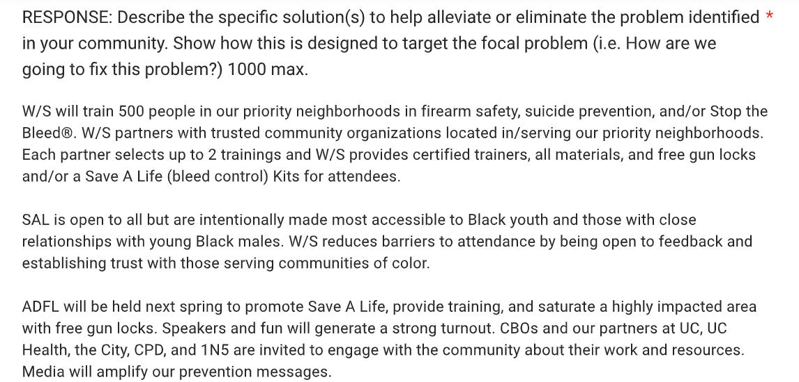
Responding to the demographics mentioned in Scanning
Answering: Who, What, When, Where, How

Slide 12
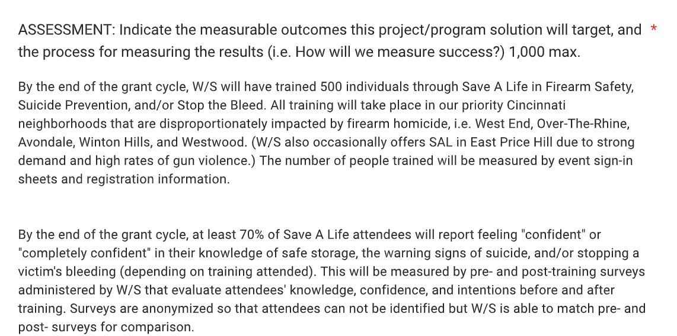
Correlates back to the Scanning

Slide 13
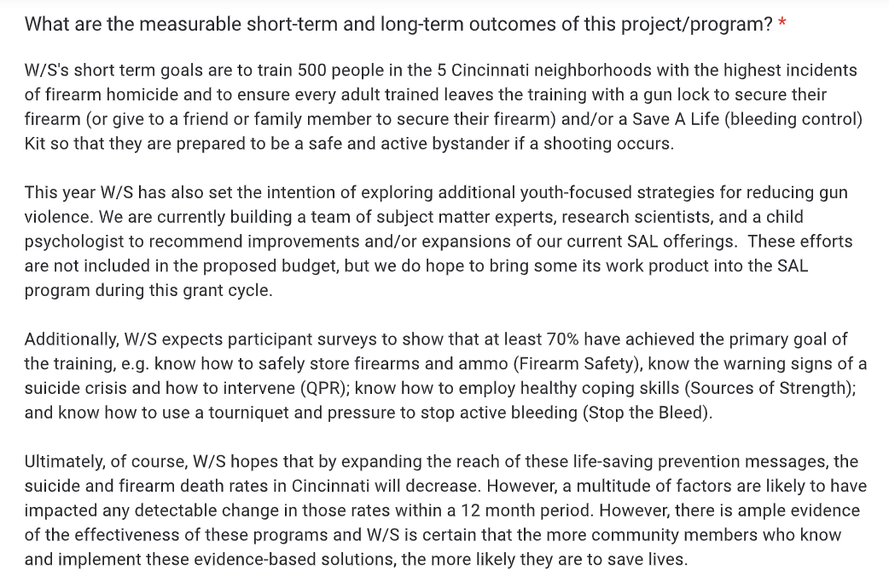
Great use of SMART goals

Slide 14
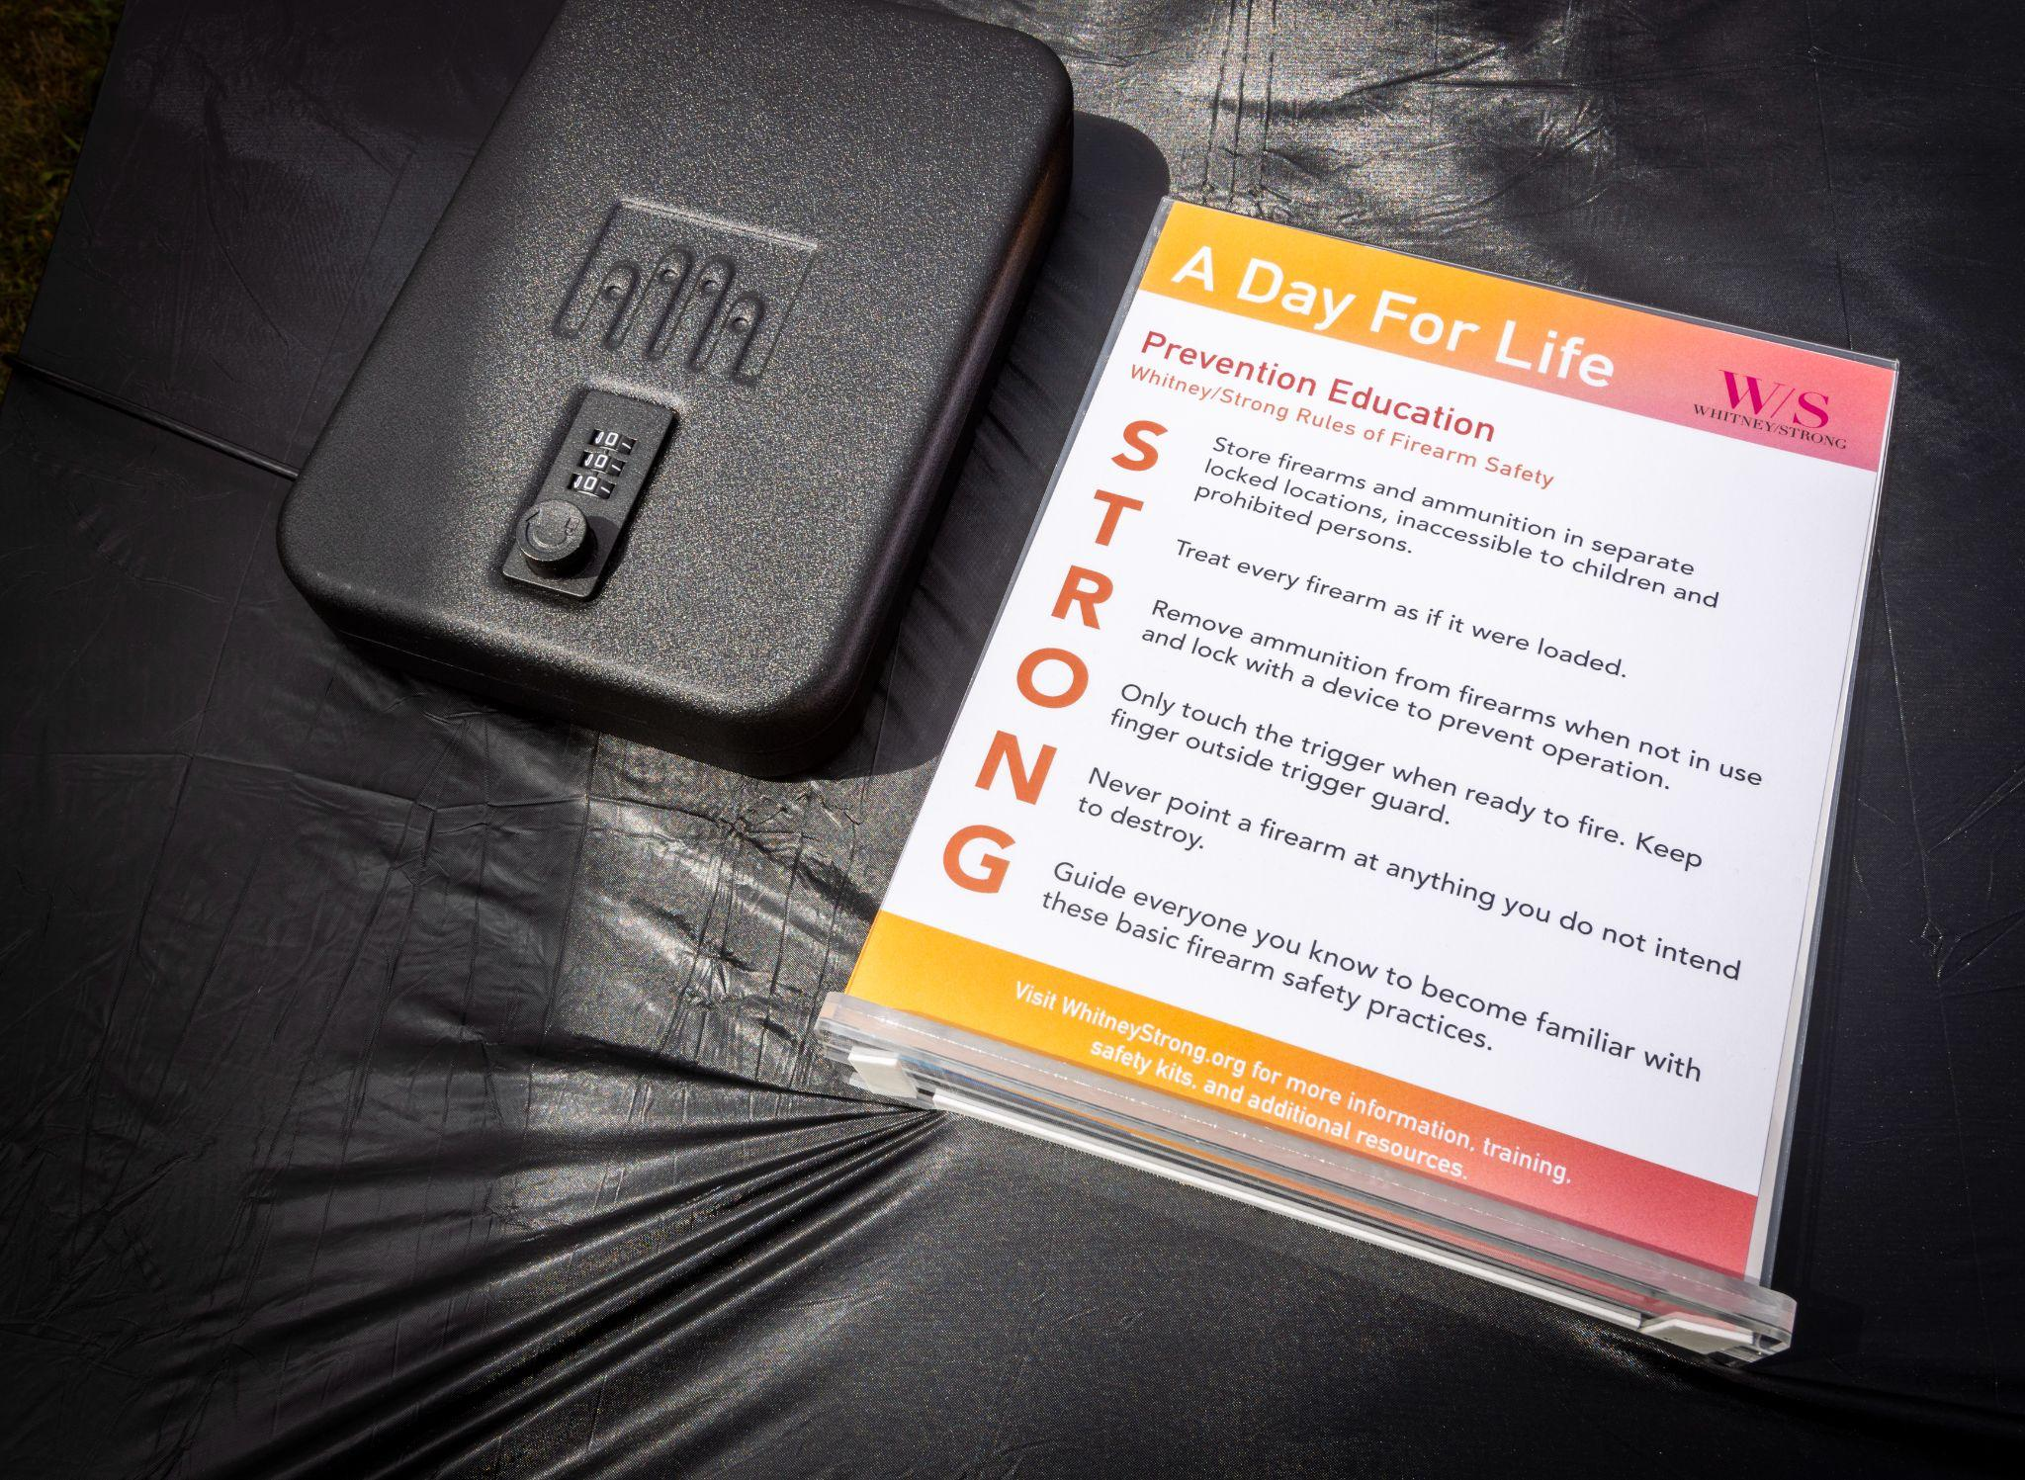
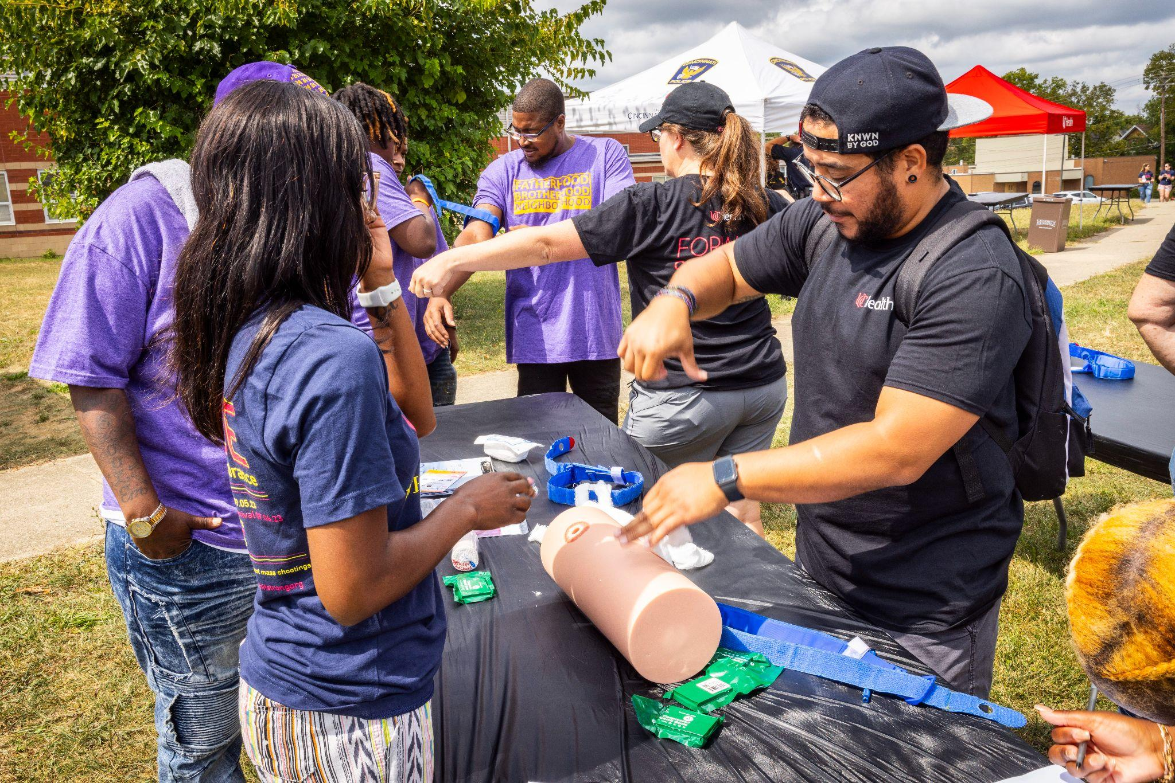
Feedback from application example:
The application was straightforward and to the point.
Scanning- Need to cite sources.
Analysis- Able to identify the why, could have included more narrative when talking about direct exposure to gun violence with storage rates. Is it the lack of education of gun safety?
Response- Who, What, When, Where, How, Why- provided good details and directly how they were going to solve in the scanning section.
Assessment- Add another metric: this would include post-grant term follow-up, post 6 months, check-in with participants.
General thoughts to be thinking: How will you know your project will be successful?

Slide 15
Example of a funded youth program:
Funds will be used to provide after-school programming to youth in Winton Hills and increase capacity building. Youth will be able to go to the community center where they be able to get tutoring, access to extracurricular activities, a snack, connect with other youth, and receive support from mentors. Youth ambassadors will go out into the community and share about the resource center and the services they provide to explore their creativity, athletic interests, and academic interests.
Gun violence prevention workshops, education workshops, and social-emotional learning workshops are part of the resource center and open to the Winton Hills community. Safe and Clean funds will be used to pay for field trips, education trips, and transportation for youth to explore their creative side and experience life outside of the low-income neighborhoods. The community center hosts community events where family, community members, Cincinnati Works, and the youth can gather and foster community pride.

Slide 16
How are Safe and Clean applications reviewed?
Keep Cincinnati Beautiful will convene a six-member Fund Advisory Committee to review grant applications and make recommendations for funding. Composition of the Fund Advisory Committee will be as follows:
One representative from Keep Cincinnati Beautiful; this representative will also serve as the Fund Advisory Committee’s convener(NON-VOTING)
One representative from Community Development and Planning
One representative from the Police Department
One representative from the City Manager’s office (ex officio member)
One representative from Public Services
One member from the private sector (representing a broad cross-section of the community) selected by Keep Cincinnati Beautiful
Nominees will serve on the Fund Advisory Committee for one year. In the case of resignation or removal of a representative, Keep Cincinnati Beautiful will replace the representative in time to participate in the upcoming round of application reviews and recommendations.

Slide 17
Tips when writing your application:
Imagine your application is being read for the first time. Does it make sense? Are all the logistical pieces in place? I may have read your proposal, but the committee has not.
Cite your references.
K.I.S.S- Keep It Short and Sweet, sometimes less is better(not to say to leave out important details but less narrative and straight to the point).
If your project includes other city departments, please make sure you’ve received the information needed from the department before applying. ex. invoice/bid from DOTE, DPS, etc.
When measuring assessment and outcomes think of S.M.A.R.T
Is it specific?
Is it measurable? Can this goal be used as a metric/number/data?
Is it achievable?
Is it relevant to Safe and Clean’s focus of youth-led projects/programs in the Top 10 Neighborhoods and the mission of Safe and Clean?
Is this goal time-based within the year term limit?

Slide 18
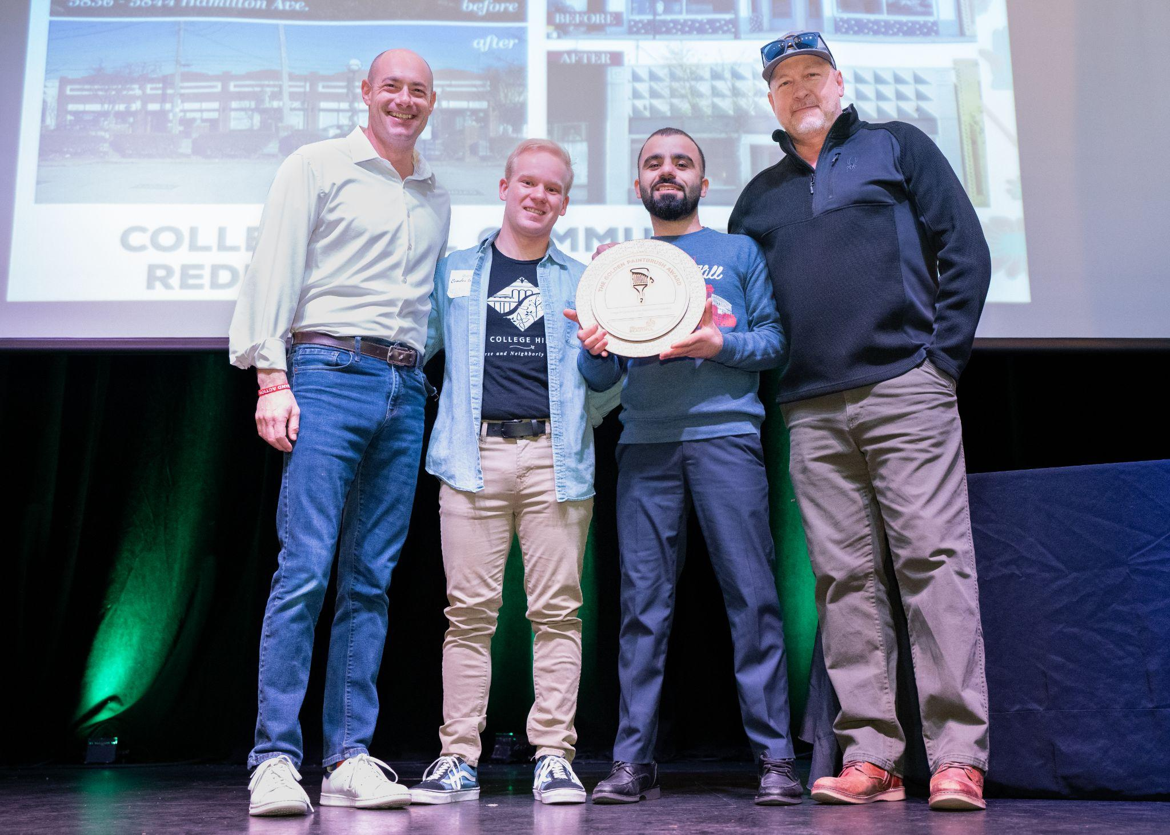
Next steps to apply for Safe and Clean Funding:
Review full guidelines here.
Reach out to Ty to discuss your project/program proposal at Ty@Keepcincinnatibeautiful.org - you must meet with Ty to be eligible for funding.
Please note attending/watching the virtual informational session(s) does not qualify for a meeting.
Applications open 30 days prior to deadline via Submittable(link will be on the website)
We will notify you on your application status no later than 30 days after the deadline.
Application Feedback is offered to applicants regardless if accepted for funding or declined at this time.
Greg Landsman with members of College Hill Urban Redevelopment Corporation(CHCURC, current S&C grantee) at Keep Cincinnati Beautiful’s 2024 Love Thy ‘Nati Awards.

Slide 19
Grant Writing/Application Resources:
Ty offers peer review/feedback prior to you submitting your application, please reach out no later than 5 days prior to the application deadline. Email: Ty@KeepCincinnatiBeautiful.org
UC Grant writing - online classes via ED2go
Cincinnati State also offers online courses via ED2go
Cincinnati Public Library: Free Resources/Classes/Workshops
Greater Cincinnati Foundation: Resources, Data, Capacity Building guides
-Grammarly - Free AI proof reading application
- Linkedin Grant Writing Webinars
City of Cincinnati- OPDA(office of performance and data analytics) - Free for public, Cincy Insights is also a good tool via ODPA.
University of Cincinnati Grant Writing Resources- Ebooks, Web Resources
Grants Plus Resources: They also offer services for nonprofits, webinars, articles, etc.

Slide 20
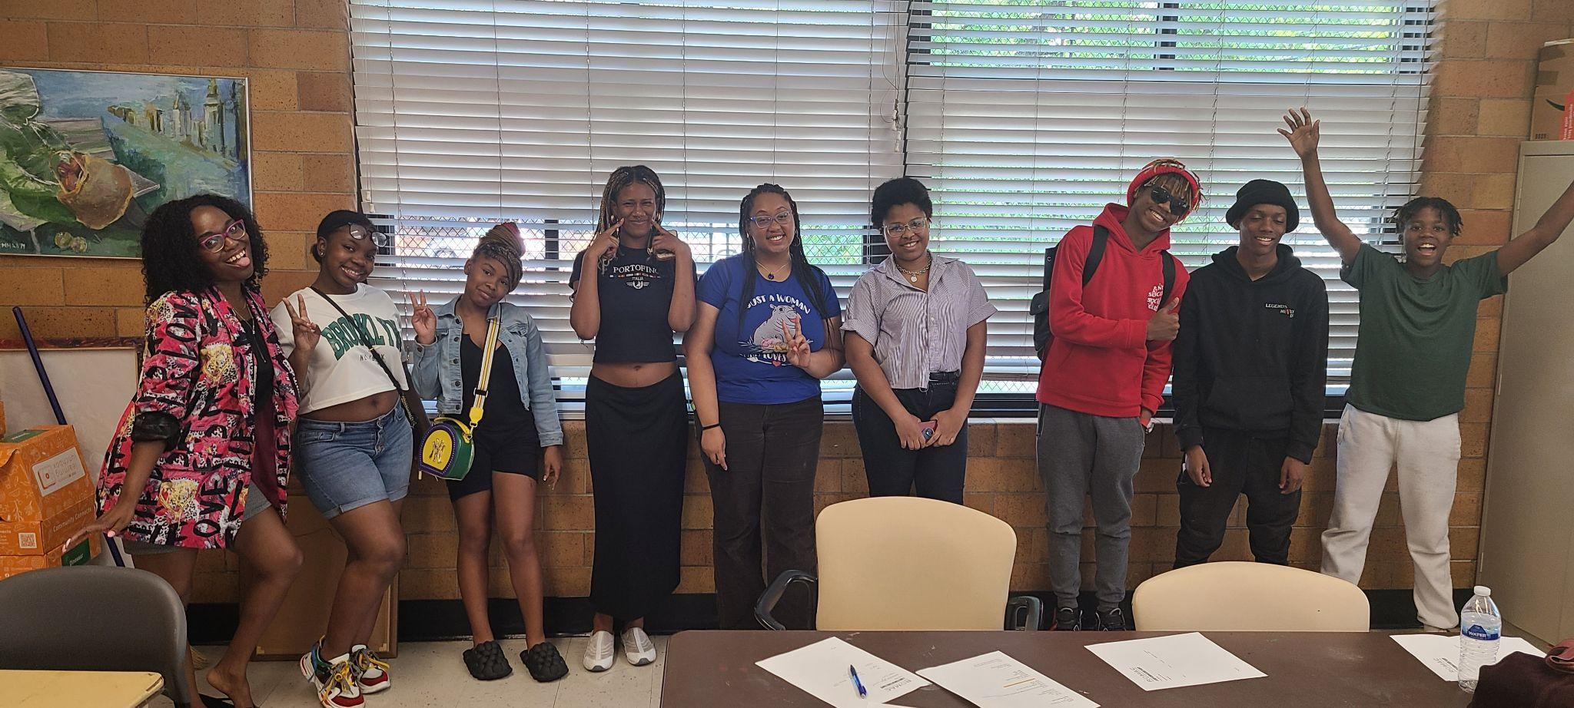
Questions? Please contact Ty Wesselkamper at Ty@KeepCincinnatiBeautiful.org
Robert O’Neal Multicultural Arts Center received Safe and Clean funds for their “Welcome to the West End Program” which included Arts4Us free public art classes (ages 5-75) and Teen Apprenticeship and Entrepreneurship Program(18 teens).

